Slide 1
GENERAL MEASURES Community Check-In
COVID-19: IN-CLASS GUIDELINES
Self-screen – How are you feeling? Remember: do not come to campus if you have a fever, sore throat, cough, difficulty breathing, runny nose, or feeling unwell. For more information: https://www.utoronto.ca/utogether/ucheck.
Vaccination - The University of Toronto will require that all those intending to be present on our campuses be fully vaccinated against COVID-19, in accordance with all applicable laws and regulations. For more information: https://www.utoronto.ca/utogether/vaccines
Hygiene – Wash hands regularly, avoid touching face, sneeze or cough into your arm, no shared surfaces or tools
Masks – Wear a mask while in-class unless given permission to remove it by the instructor or have an accommodation/exemption. For more information, please refer to the Policy on Face Masks: https://governingcouncil.utoronto.ca/secretariat/policies/face-masks-policy and the Joint Provostial Guidelines on Face Masks: https://www.provost.utoronto.ca/planning-policy/joint-provostial-and-human-resources-guideline-on-facemasks-at-the-university-of-toronto/
Traffic Flow – Follow the designated traffic flow for entering, moving through, and exiting room
Physical distancing outside of the classroom/non-instructional spaces – Follow physical distancing outside of the classroom.
Furniture Placement – Use designated furniture, do not move furniture without permission
Sept 1, 2021
Notes:
Please refer to Instructional Guidelines document for more information

Slide 2
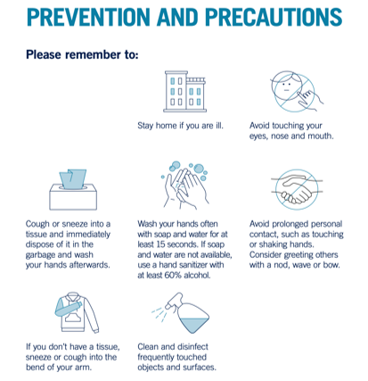
REMEMBER…
What we can do to keep us all safe.
Sept 1, 2021
Notes:
Use this graphic to provide a visual and verbal reminder of the general COVID-19 prevention measures and any other protocols required by your division
Full poster available for download: https://ehs.utoronto.ca/wp-content/uploads/2020/03/Covid-19-Poster_8.5x11_FA.pdf

Slide 3
WHAT TO DO IF UNWELL?
COVID-19: IN-CLASS GUIDELINES
Non- Urgent:
Report your sickness to your course instructor
Go home
Email U of T’s Occupational Health Nurse (ehs.occhealth@utoronto.ca) who will conduct assessment and contact tracing, and will provide further direction
NOTE: The University has suspended the need for a doctor’s note or medical certificate for absences if experiencing COVID-19 symptoms.
Sept 1, 2021
Notes:
Please refer to Instructional Guidelines document for what do if in both urgent and non-urgent medical situations

